Slide 1
Research Overview
Rashmi Agrawal

Slide 2
Challenges in Processing Large Power-law Degree Graphs

Slide 3







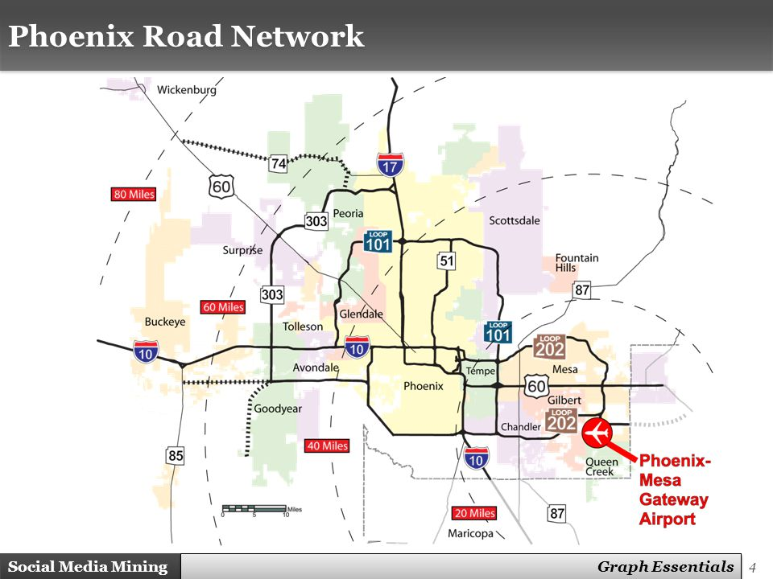


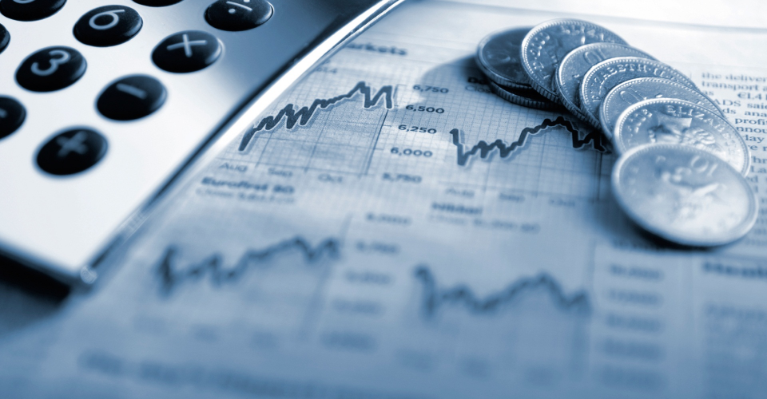
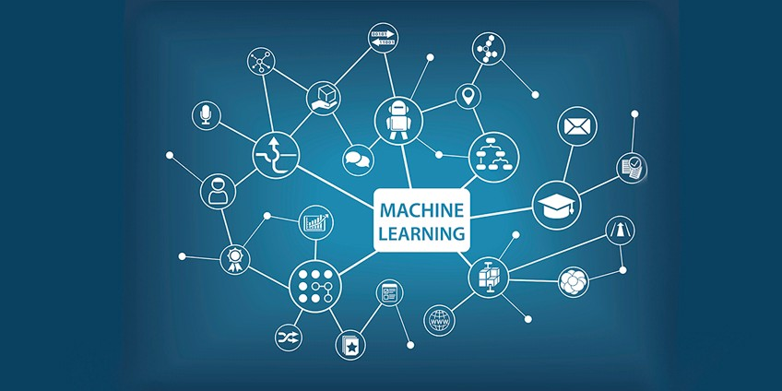
Graph-Based Applications
Social Network Analysis
Bioinformatics
Web Analysis
Shortest paths/Fastest routes
Advertising
Network Optimizations
Cyber Crime
Financial Transactions
Machine Learning
Notes:
Graph-based applications cover a wide range of spectrum. From community detection in social networks to genome analysis, ranking web pages, user ratings for products and services, finding routes for self driving cars, robots and so on.

Slide 4
Graph Computing Rational
Improvements in data collection capabilities have led to the rapid increase in data analysis complexity
Graphs lend themselves well to presenting complex data and relationships
Many problems in computation and data analysis can be framed by graphs and solved using well known graph algorithms
Example:
Alice
friend
cousin
V = {A, B, C, D, E}
E = {(A,B),(A,C),(A,E),(B,D),(B,E),(C,E),(D,E)}
Bob
Chris
colleague
friend
colleague
Dave
sibling
friend
Eddie
Notes:
And this is because graphs can be easily leveraged to present complex data and relationships. Hence problems in computation and data analysis can be represented using graphs and solved using existing graph algorithms.

Slide 5
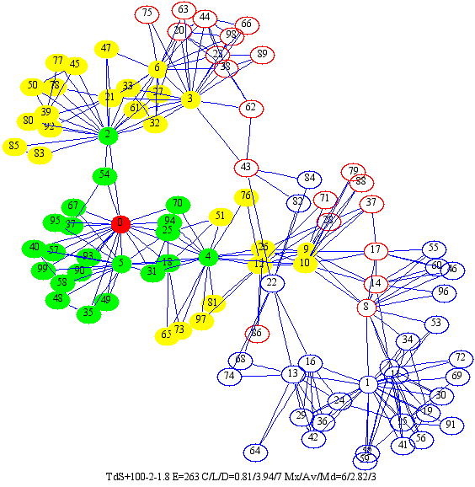
Properties of Real-time Graphs
Real-time graphs are
Large i.e. have billions of vertices and edges
Have rich metadata
Power law distribution
Sparse
Highly irregular
Notes:
A real time graph has large number of vertices and edges in the range of billions, have rich metadata and one of the important property they have is power law degree distribution i.e. few nodes have many neighbors and many nodes have few neighbors. And hence they are sparse and highly irregular.

Slide 6
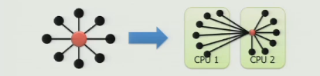
Issues with Graph Processing
Scattered memory accesses:
Poor cache performance
Poor prefetching and
Poor branch prediction
Memory intensive:
Low compute to memory ratio
Memory access latency
Memory bandwidth utilization
Inefficient graph partitioning
Performance tuning required per input/algorithm basis
Hyperthreading:
Inefficient load balancing
Synchronization issues
Communication latency
Notes:
Random memory accesses lead to low spatial and temporal locality and we see caches, prefetchers and branch predictors performing poorly. As a result, the memory access latency becomes higher. Small computations do not hide the memory access latency and lead to low compute to memory ratio. Use of hyperthreading gives rise to inefficient load balancing between threads and also synchronization overheads.

Slide 7
Proposed Graph Processor Architecture
Notes:
To overcome these challenges, we propose a customized graph processor. The graph processor has a systolic array fashion arrangement of processing elements where each processing element can operate independently using globally asynchronous and locally synchronous principle. This work is under progress. Plan is to implement this architecture using RISC-V cores. Shanshan is working on figuring out the asynchronous circuit digital equivalent that will be used for communication between the processing elements.

Slide 8
Post-Quantum Cryptographic Hardware Primitives

Slide 9
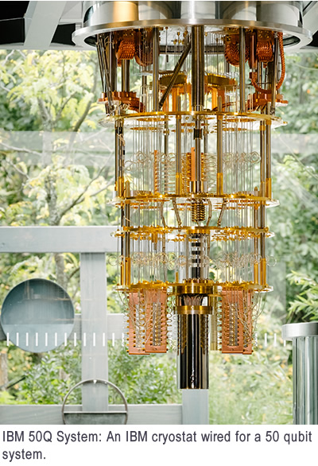
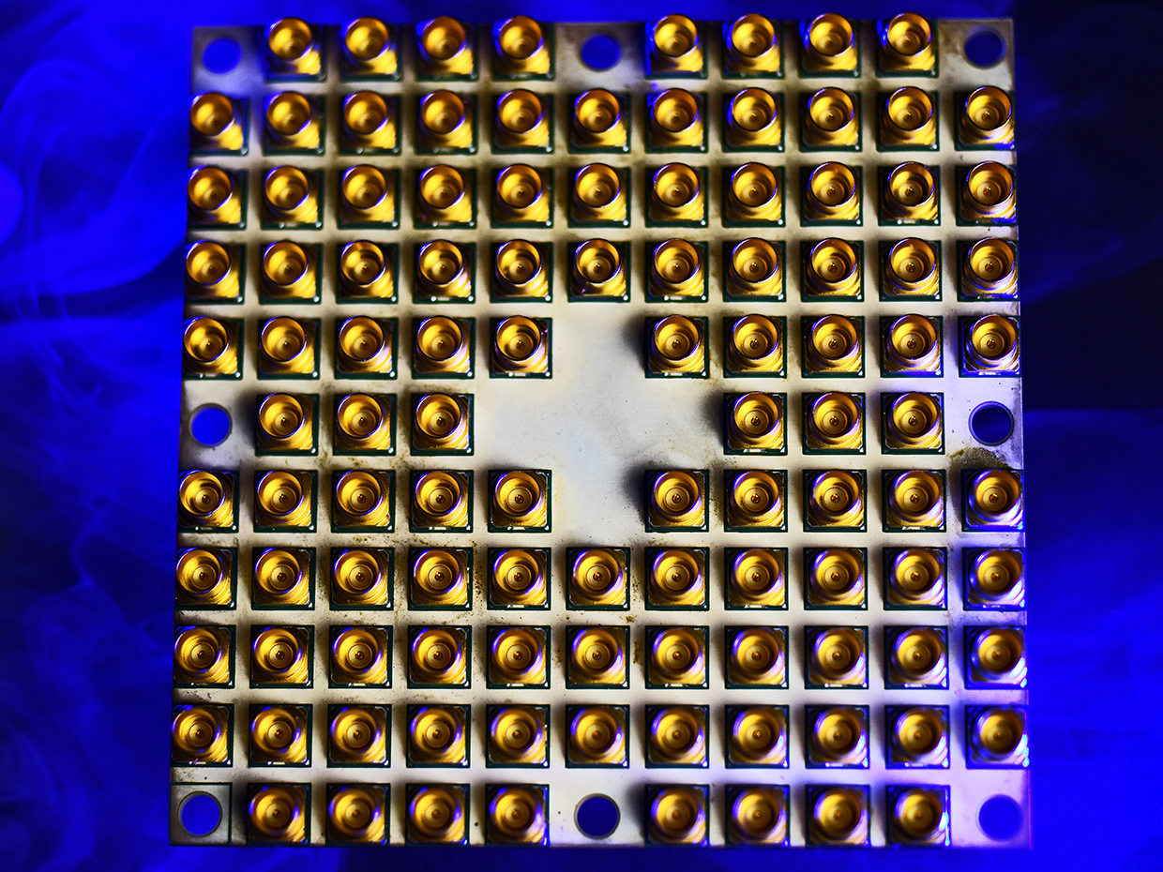
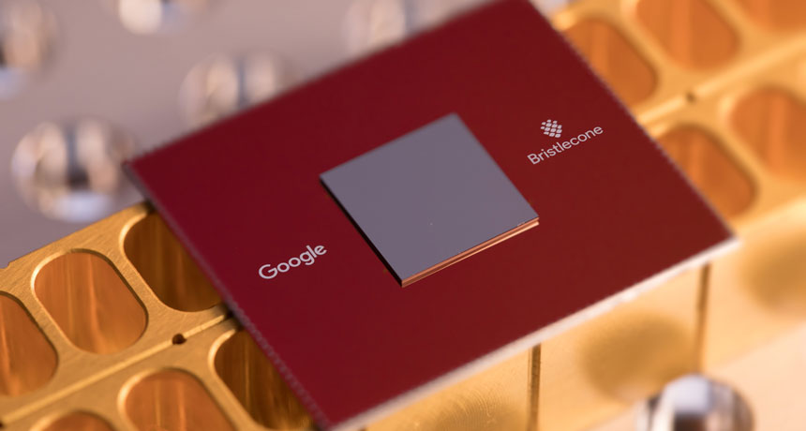
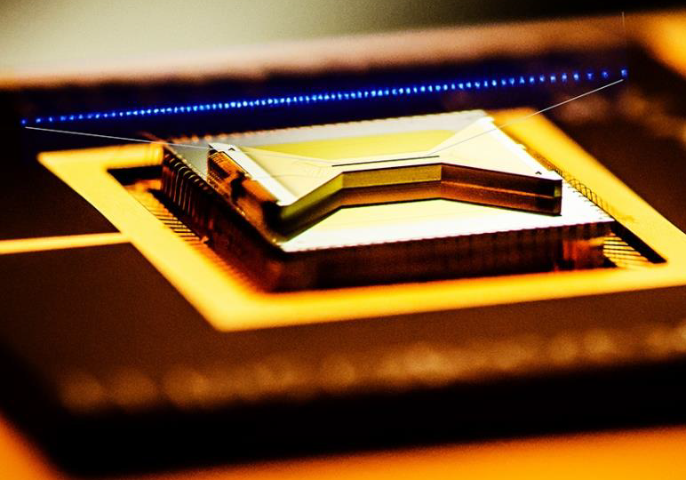
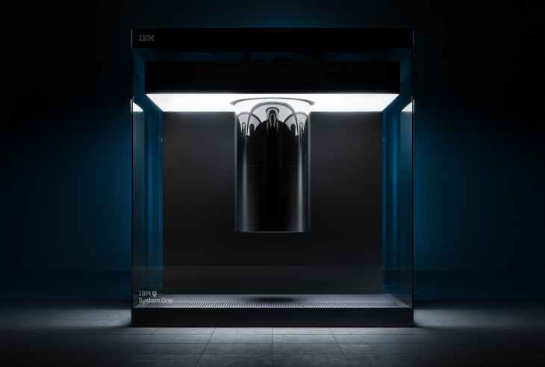
Ongoing Development
Intel 49 Qubits
Google 72 Qubits
IBM 50 Qubits, 20 Qubits
IonQ 160 Qubits
Notes:
Here we can see the ongoing development in the field of Quantum Computers. Hence with the ongoing developments….
Qubits mentioned here are Physical qubits & actual useful qubits or the logical qubits may be just ½ or 2/3 of the physical qubits. Typically many physical qubits get used up to provide stability, error-correction and fault tolerance needed to perform useful computations

Slide 10
When Quantum Computers Come…
Who is considered as post-quantum secure?
Victims: banks, smartphone apps, DocuSign,
web surfing, governments, military, etc.
Algorithm | Secure in Post-quantum Era?
RSA-1024, -2048, -4096 | No
Elliptic Curve Crypto (ECC)-256, -521 | No
Diffie-Hellman | No
ECC Diffie-Hellman | No
AES-128, -192 | No
Notes:
NIST published an interesting survey which shows that when quantum computers get commercialized most of the classical cryptographic algorithms for symmetric key exchange will not be secure and none of the Public key algorithms will be secure. With quantum supremacy even the 4096 bit RSA algorithm will not be secure.

Slide 11

Quantum Computer-based Cryptography vs General Computer-based Quantum-proof Cryptography
Notes:
Having to develop quantum computer-based cryptography is rich man’s solution like Iron man & batman. Developing conventional computer based quantum proof solutions is a common man’s approach like spiderman.

Slide 12


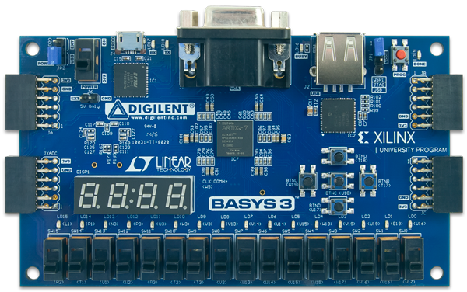
An Affordable, Accessible, and Expandable Solution for the Next 10 Years
Notes:
We would envision that, for 5-10 years, silicon based Quantum-Proof solutions such as FPGA will still be mainstream for researchers, banks and various govt. agencies. Another advantage is that what ever Quantum-proof is getting implemented now on FPGA, can still be implemented on Quantum Computers. So, we are building a solution for now and for tomorrow.

Slide 13
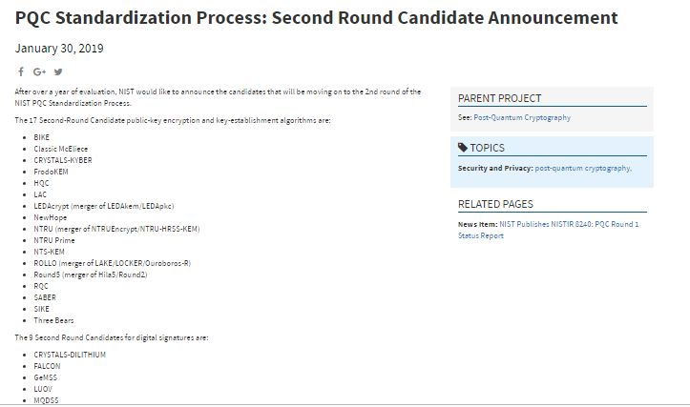
Post-Quantum Cryptography (PQC) Standardization (Round -2)
NIST
Jan 30, 2019 published candidates of Round-2:
27 submissions
Who survived?
12 lattice-based
8 code-based
some multivariate-based and hash based for digital signatures
Notes:
Also NIST is in the process of standardizing Post-quantum crypto and On Jan 30, 2019 NIST published first round results. Out of some 69 submissions only 27 submissions were declared as the second round candidates which consisted of mainly of Lattice based and code based cryptosystems and few other multivariate and hash-based for digital signatures.

Slide 14
Post-Quantum Cryptography (PQC) Standardization (Round -2)
 | Public-Key Encryption
 | Lattice-based/Ring-LWE |  | Code-based |  | Other
1 | NTRU Prime | (R-lattice) | Classic McEliece | (Binary Goppa)
2 | NTRU European Encryption Standard | (R-lattice) | HQC | (BCH & cyclic)
3 | LAC | (R-LWE) | RQC | (cyclic)
4 | SABER | (Mod-LWR) | LEDA | (LDPC)
5 | Round5 | (R-LWR) | ROLLO (LAKE & LOCKER) | (LRPC)
 | Digital Signature
 | Lattice-based/Ring-LWE
1 | FALCON | (NTRU R-lattice)
2 | qTESLA | (R-LWE)
3 | CRYSTALS-DILITHIUM | (R-LWE)
 | Key Establishment/Encapsulation
 | Lattice-based/Ring-LWE |  | Code-based |  | Other
1 | NewHope | (R-LWE) | BIKE | (MDPC) | SIKE (Isogeny)
2 | NTRU European Encryption Standard | (R-lattice) | NTS-KEM | (Binary Goppa)
3 | FrodoKEM | (R-LWE) | LEDA | (LDPC)
4 | CRYSTALS-KYBER | (R-LWE) | ROLLO (LAKE & LOCKER) | (LRPC)
5 | SABER | (Mod-LWR)
6 | Three Bears | (Mod-LWE)
Notes:
The detailed list of the round-2 candidates is presented here. Right now our focus is on Public key Encryption schemes and hence first we developed a Ring-LWE based PKC and right now we are working on implementing the co-processor for code-based cryptosystem.

Slide 15
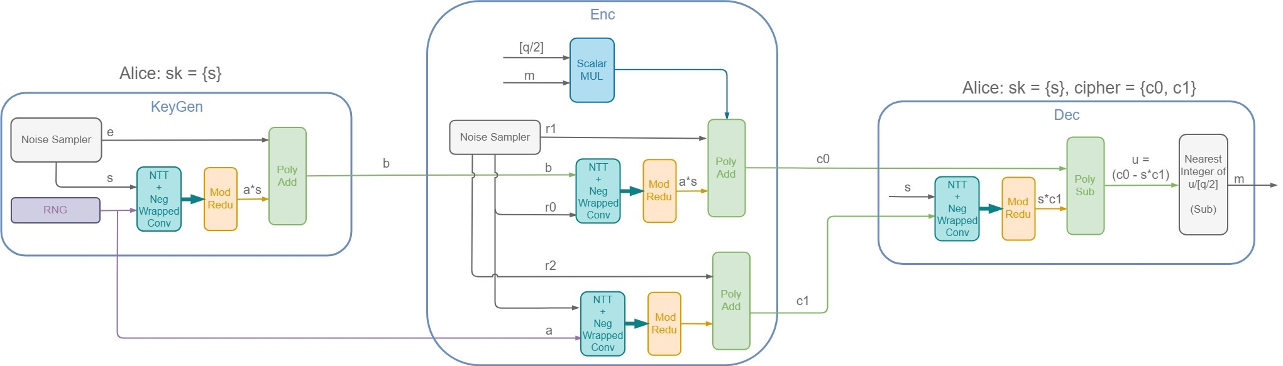



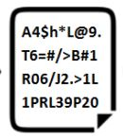
R-LWE Public Key Encryption Co-processor
TRNG
Key Generator
Module
Encryption Module
Decryption Module
Gaussian Noise
Sampler
e
r0, r1, r2
Gaussian Noise
Sampler
[1] Oded Regev, “On lattices, learning with errors, random linear codes, and cryptography”, 2005
Notes:
RLWE based public-key cryptosystem has 3 major modules. Each module breaking down into few key operations like polynomial multiplication, addition and subtraction. Already finished Implementation and presenting paper in FPL 2019.

Slide 16
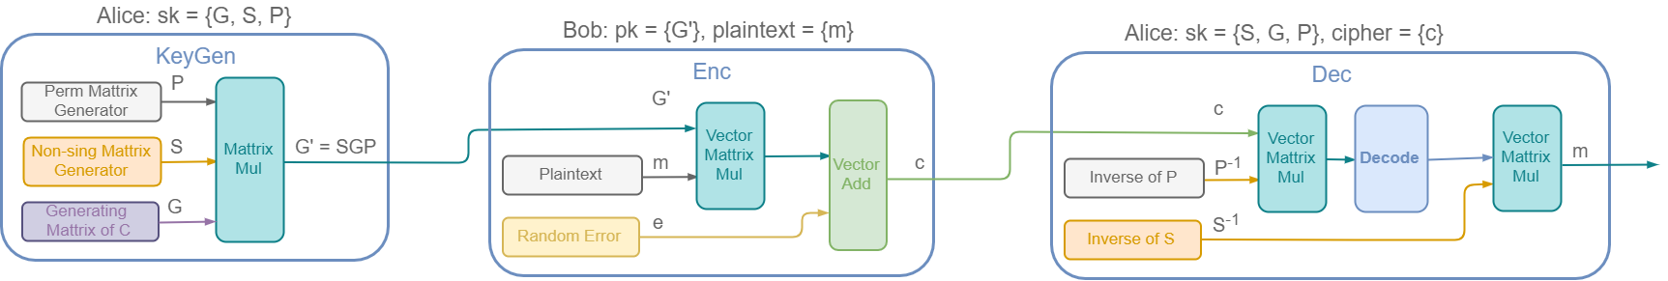
Code-based Encryption
Architecture
Key Generation
Encryption
Decryption
Notes:
For code-based encryption scheme we propose a variant of McEliece cryptosystem and instead of binary Goppa codes we make use of OLSC. The three key modules come down to few key operations like matrix multiplication, vector-matrix multiplication and vector addition. This work is under progress.

